Slide 1
Data 604 Final Project
Simulation on Monthly Staffing Demands for a Research Center
Sherranette Tinapunan

Slide 2
Research Center
Guests at a center can reserve research stations through several kiosks.
Number of guests visiting the center tends to be higher around the summer months.
Reservation kiosks can malfunction sometimes and generate defective tickets.

Slide 3
Research Specialists
Research specialists assists guests with their research.
Guests expect one-on-one attention for any questions that they may have.
There are full-time research specialists at the center.

Slide 4
Defective Reservation Tickets
Defective reservation tickets don’t have login code required to access research stations.
This requires special staff attention.
Staff may need to refund or create complimentary sessions.
Staff may need to follow restart procedure to reset the malfunctioning kiosk and may need to contact IT for further assistance.
Staff needs to be trained handle this issue

Slide 5
Staffing needs at a Research Center
This simulation considers staffing needs for research specialists and designated staff that manages defective reservation tickets.
Center may need to hire seasonal research specialist during busy months.
Center may need to hire or train a designated staff to manage defective tickets.

Slide 6
Full-Time Capacity of Center
For the purpose of this simulation, I set the full-time staff capacity of the center to 150 reservations per day.

Slide 7
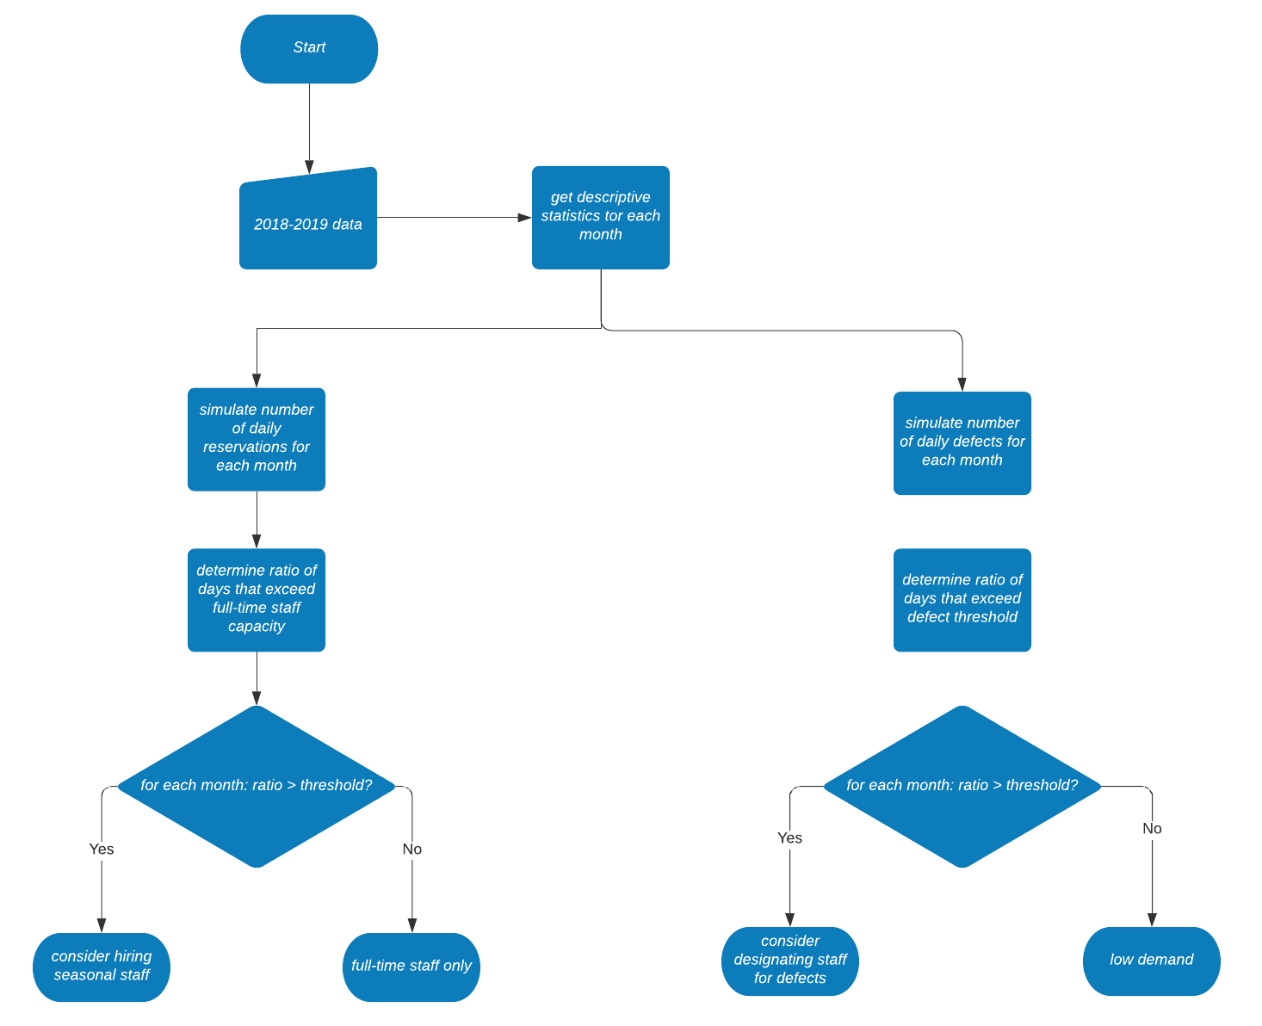
Flow of Simulation Process

Slide 8
Reservation and defect data from 2018 - 2019
Data from two-year period is used to estimate parameters for each month
For each month, following where determined:
Mean of daily number of reservations
Mean of daily number of defects

Slide 9
Poisson Distribution
To simulate daily number of reservation and daily number of defects, the Poisson distribution was used.
10,000 simulations were run for each month.

Slide 10
Staffing Recommendations
Simulation output for reach month is used to determine ratio of number of days that exceed full-time staff capacity of 150.
Monthly simulation output was also used to determine ratio of number of days that have more than one defective ticket.
If ratio exceeded a given threshold (set at .50 in the exercise), output recommends considering hiring of seasonal staff or designated a trained staff to handle defects.

Slide 11
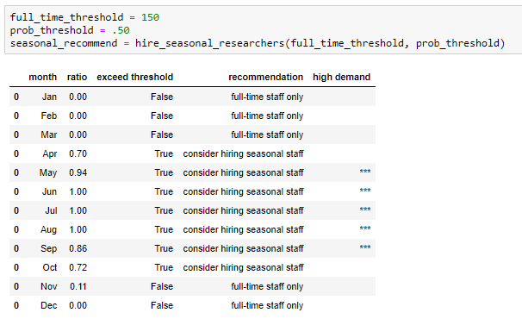
Results for Research Specialists

Slide 12
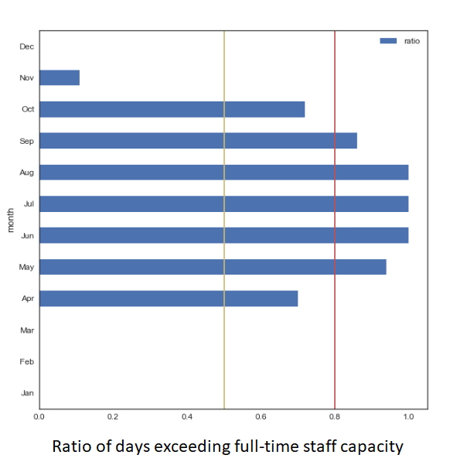
Results for Research Specialists

Slide 13
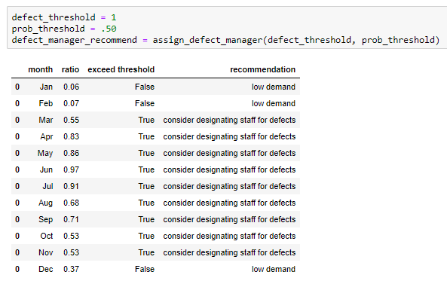
Results for Designated Defect Staff

Slide 14
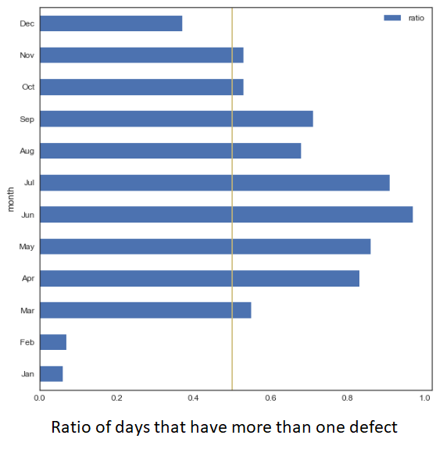
Results for Designated Defect Staff

Slide 15
Conclusion
Summer months have increased demands on both research specialists and designated staff for defective tickets.
From April – October, more 50% of the days in the month exceed full-time staff capacity.
From May – September, more than 80% of the days in the month exceed full-time staff capacity.
Designated staff for defects is recommended for all months except January, February, and December.

